Slide 1
Disclaimer/s
We hope you find the information on our website and resources useful.
Animations
This resource has been designed with animations to make it as fun and engaging as possible. To view the content in the correct formatting, please view the PowerPoint in ‘slide show mode’. This takes you from desktop to presentation mode. If you view the slides out of ‘slide show mode’, you may find that some of the text and images overlap each other and/or are difficult to read.
To enter slide show mode, go to the slide show menu tab and select either from beginning or from current slide.
You may wish to delete this slide before beginning the presentation.

Slide 3
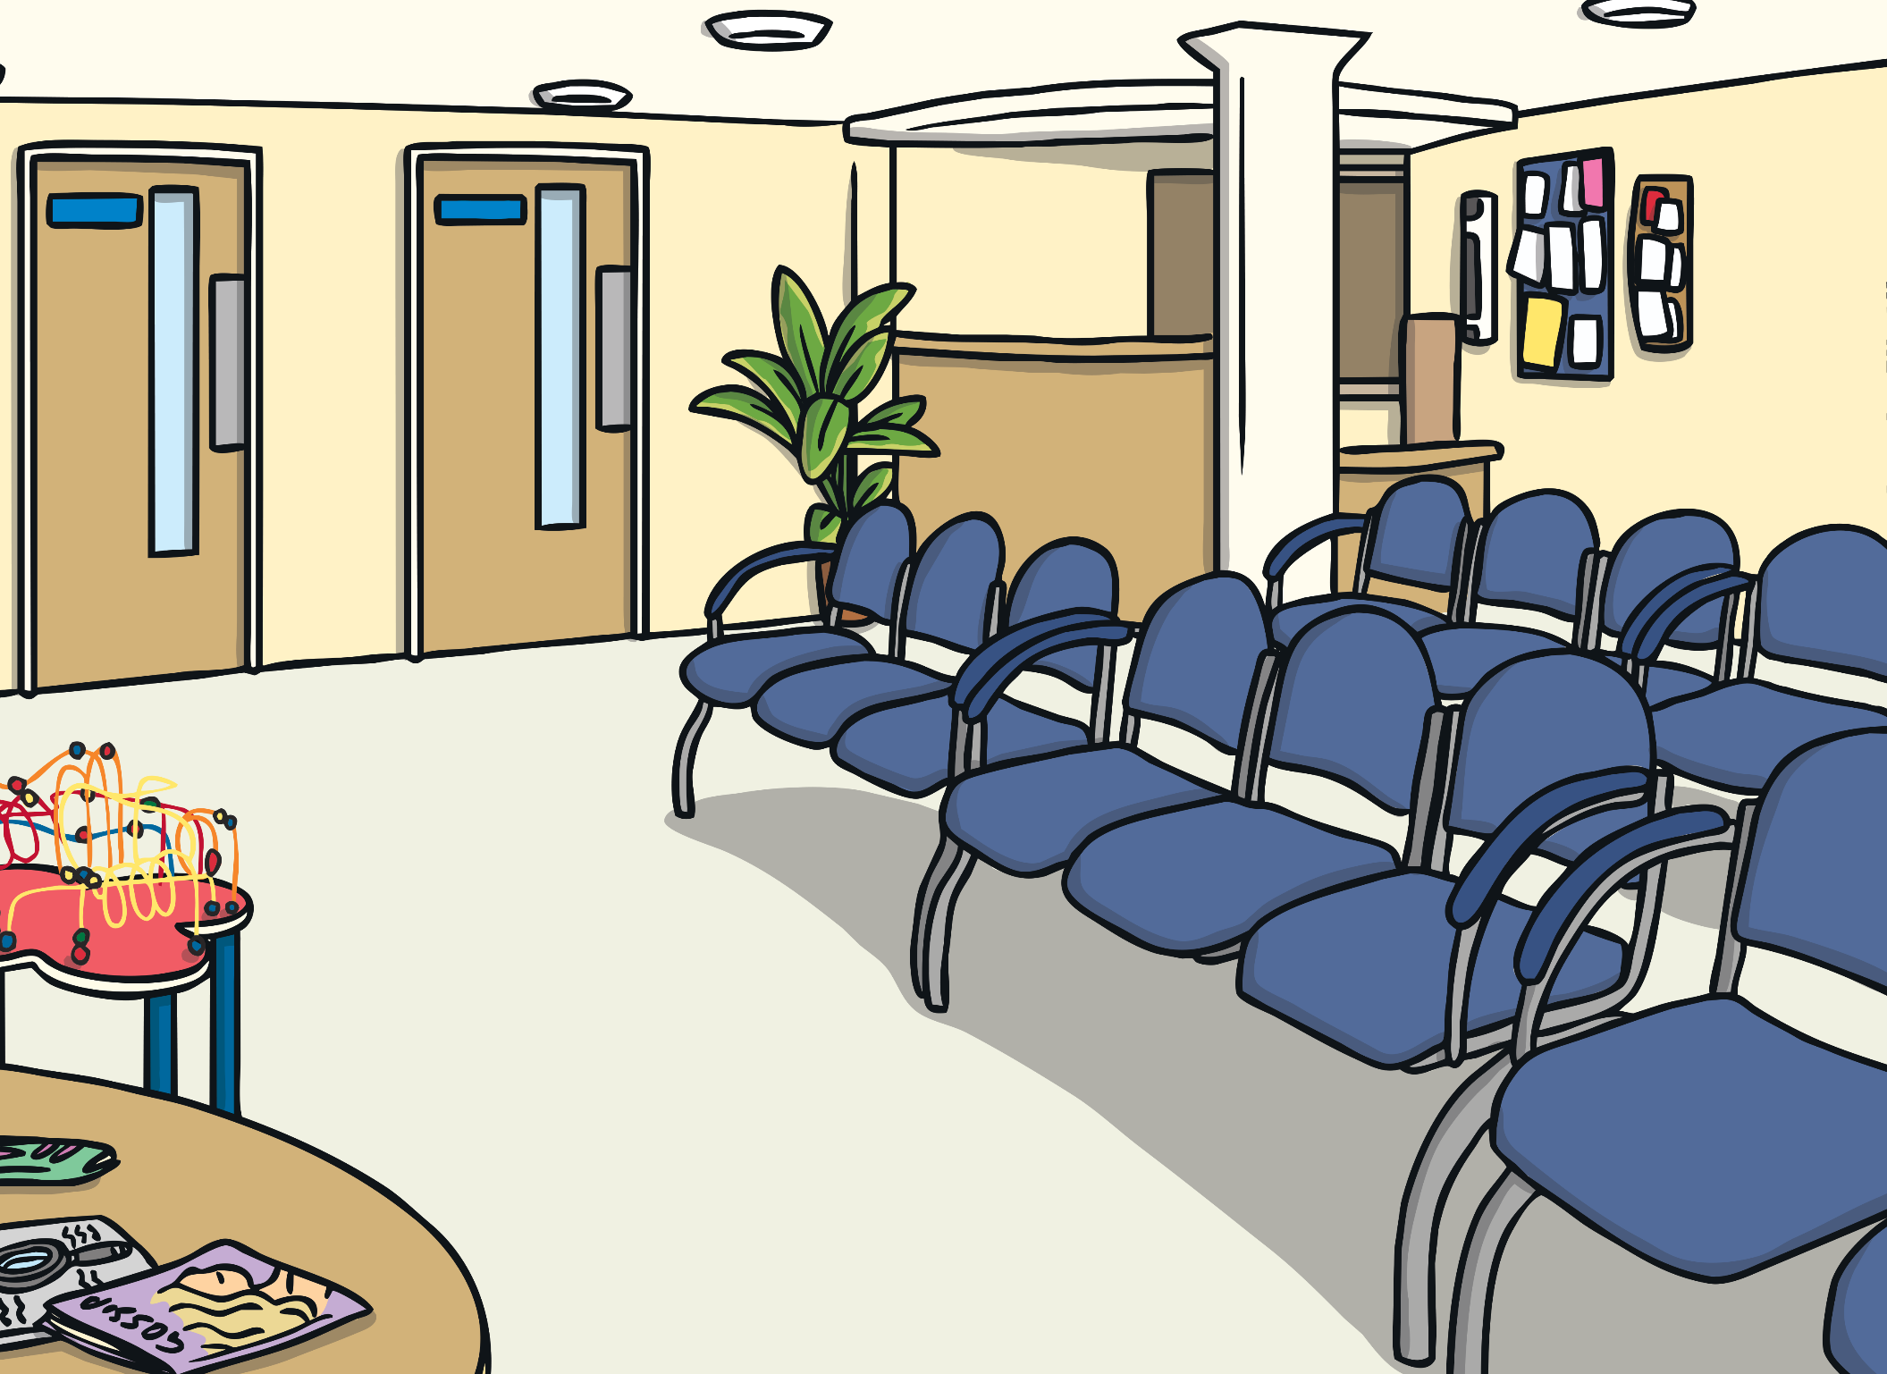
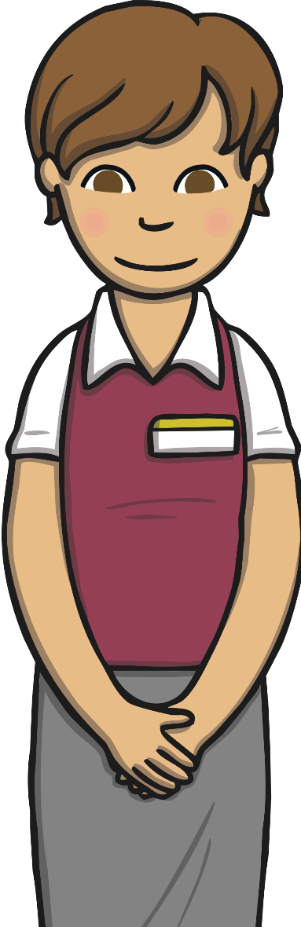
This is the waiting area. Sometimes, if the dentist is busy, you wait here until they are ready to see you.
Welcome to the dentist’s.
I am so pleased that you have come to show us your lovely smile!

Slide 4
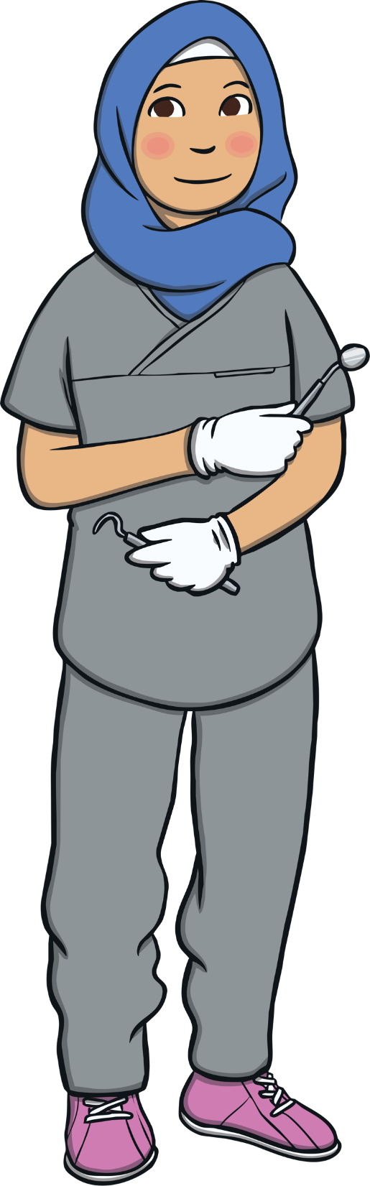
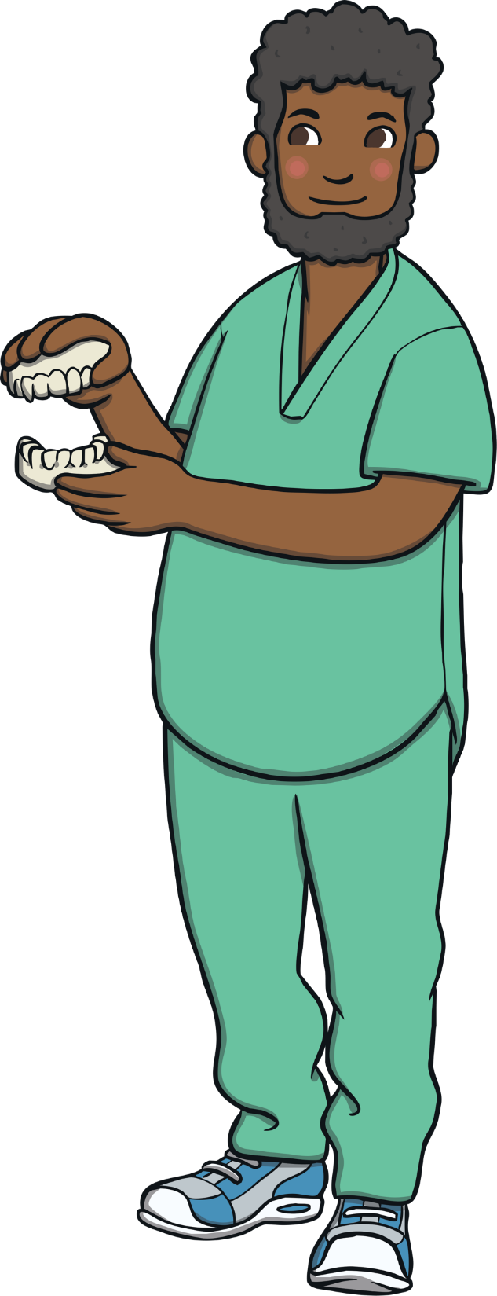

I am a dentist. I help you to keep your teeth healthy and clean.
I am a dental nurse. I help the dentist and care for your teeth.
I am a receptionist. I help to book your appointments.

Slide 5
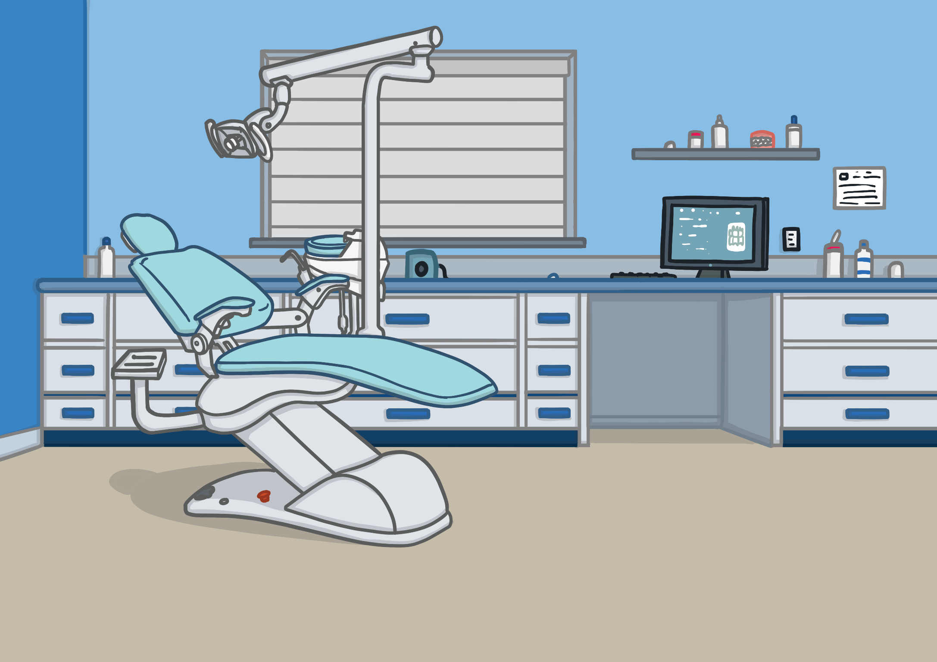
When the dentist is ready, you will come into a room like this. There are lots of things to see in this room. Let me show you around.

Slide 6
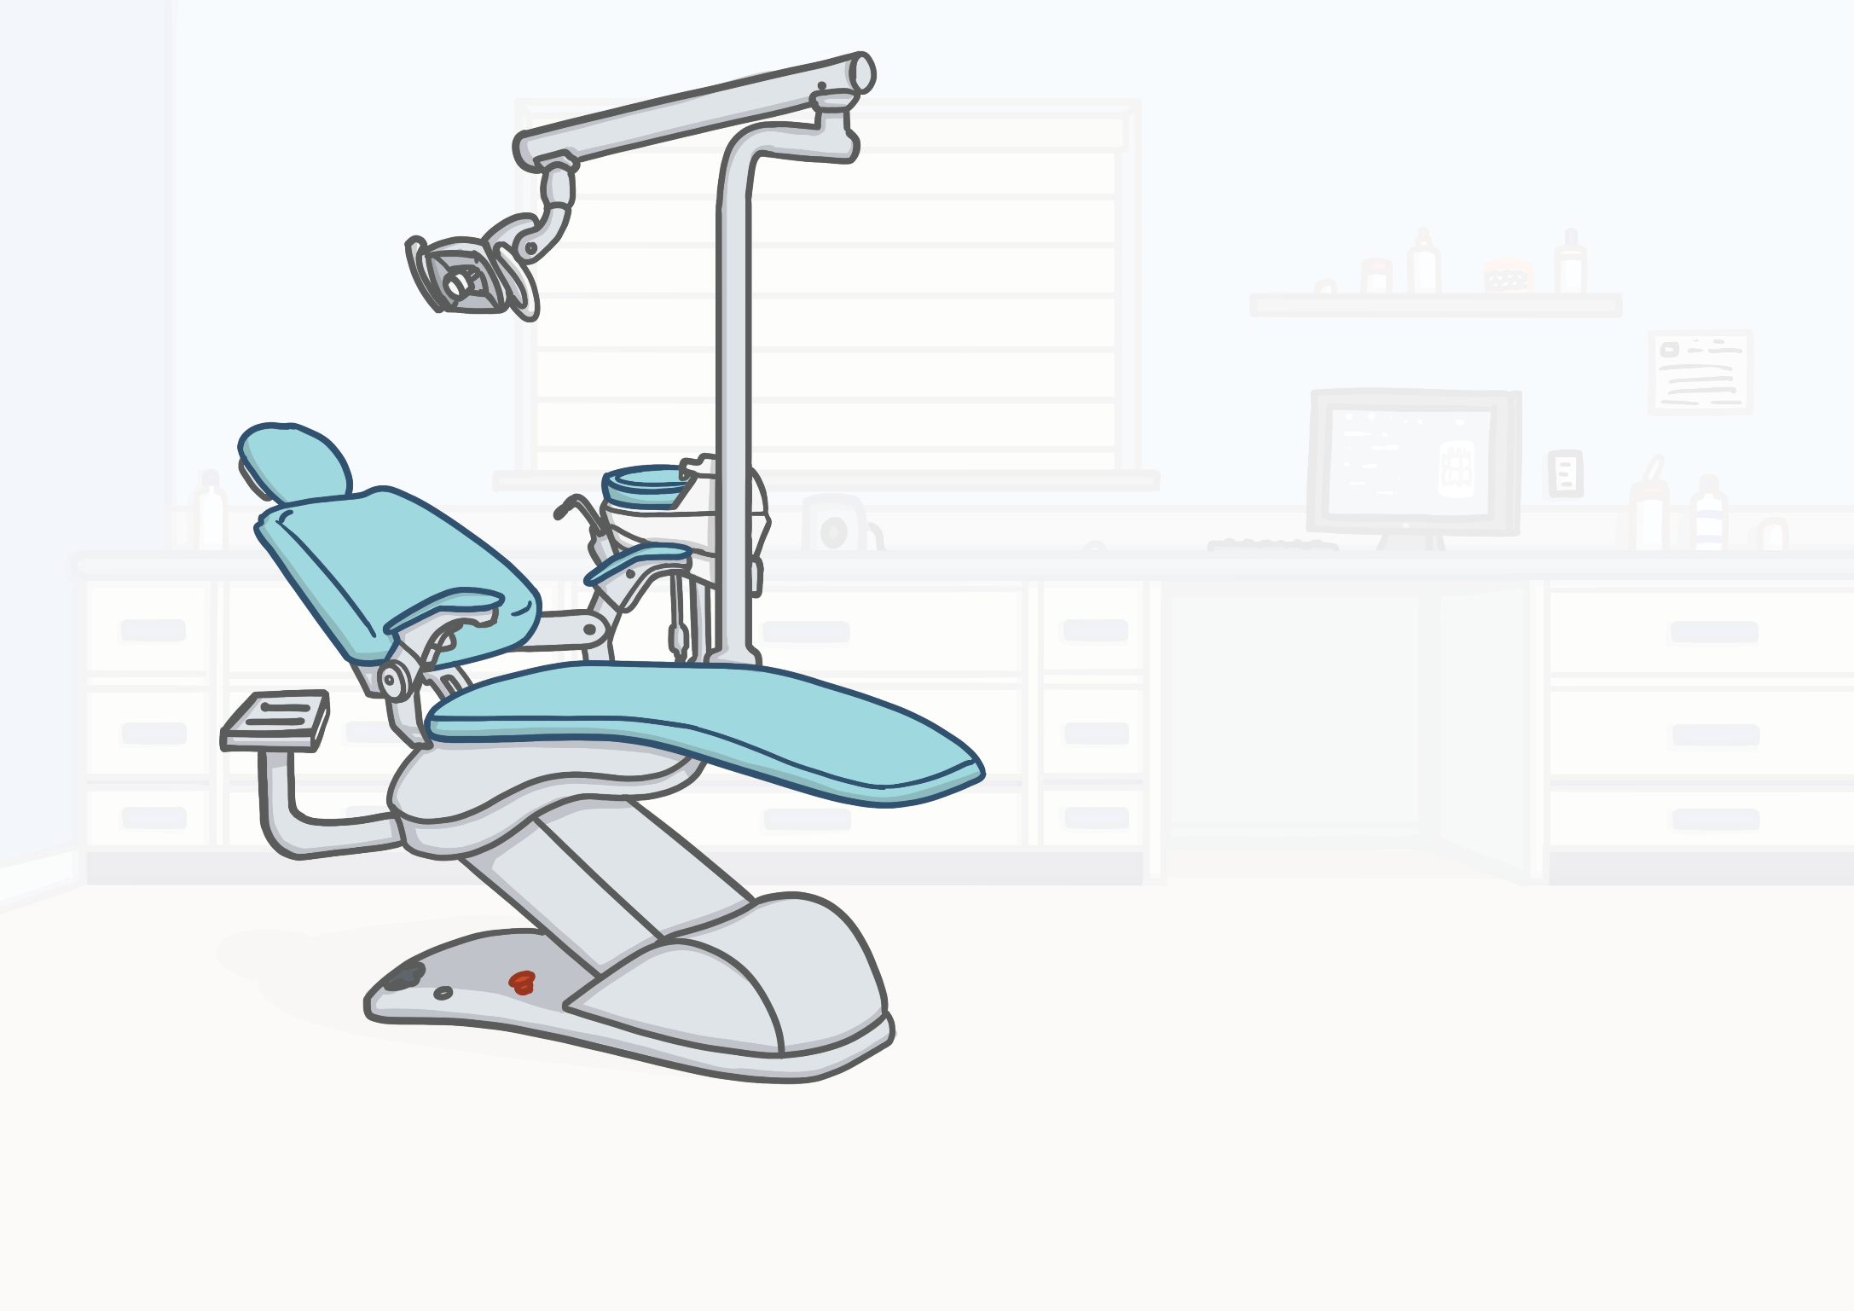

This is the special dentist chair.
The chair moves slowly up and down, which is lots of fun!
It helps to lie you backwards so that the dentist can easily see inside your open mouth.

Slide 7
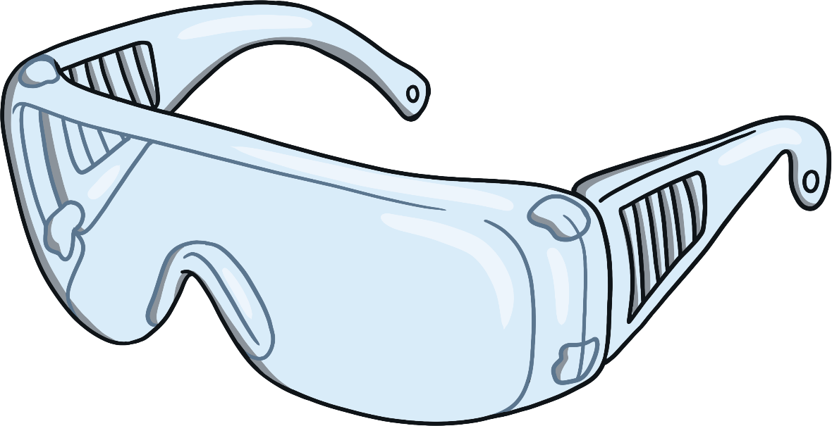
Sometimes, you might be asked to wear some safety glasses, like these. This is just to stop anything getting in your eyes.

Slide 8
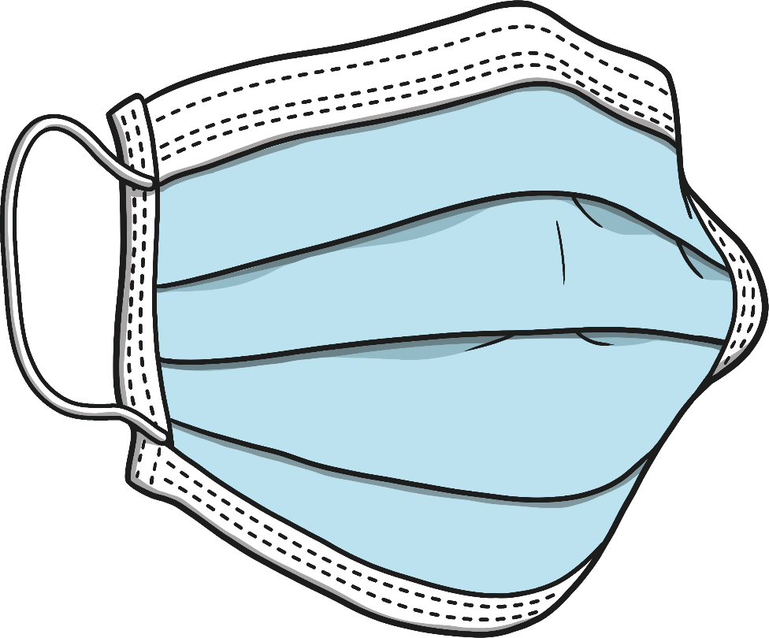
The dentist may also wear a face mask. This is to keep everyone safe from any germs.

Slide 9
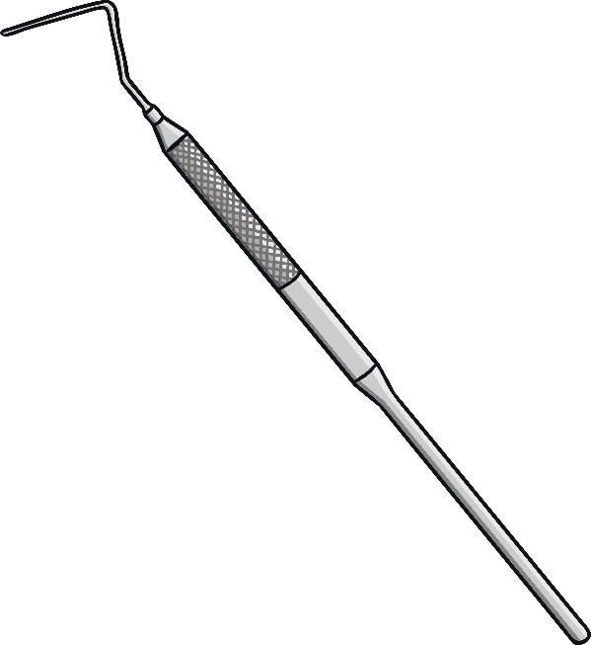
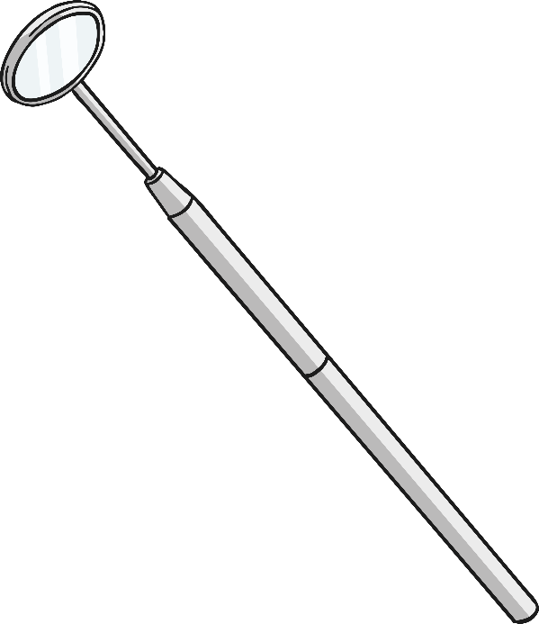
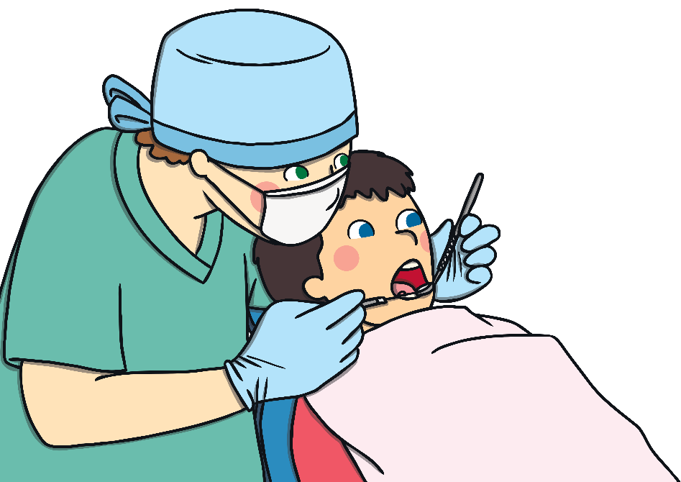
When we say ‘open wide’, we want you to open your mouth wide.
We will look in your mouth at your teeth to check that they are clean and healthy.
Sometimes, we will use special tools like these.

Slide 10
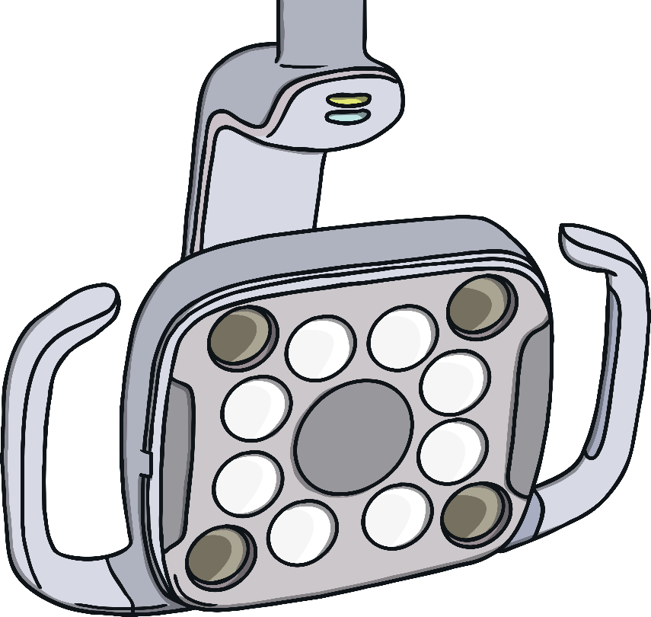
Above the chair, there is a large light, like this one. We may switch the light on so that we can see your teeth clearly.

Slide 11

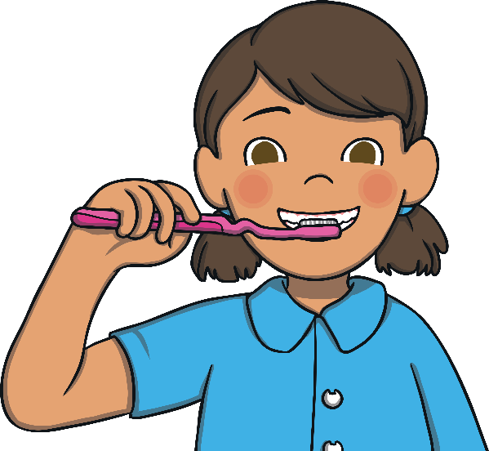
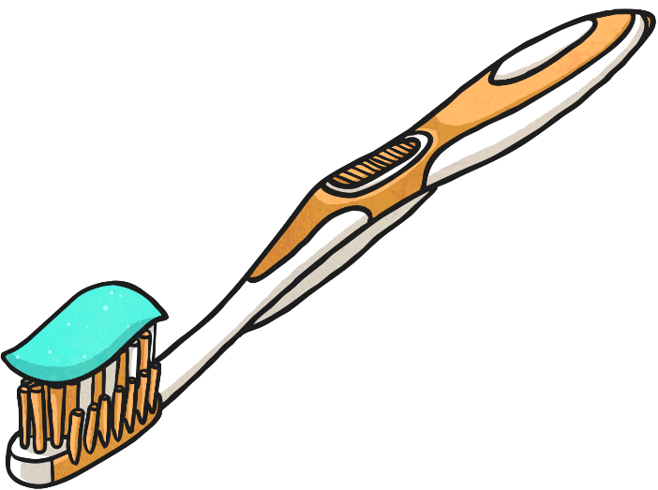
When we look at your teeth, we check to see if they are healthy and clean. If we spot any problems, we can fix them.
Sometimes, we might talk to you about how to carefully brush your teeth at home to keep them nice and healthy.

Slide 12



Now, your visit is over. We are always pleased that you visited because it helps us to know that you are looking after your teeth.
Sometimes, you get a special sticker!

