Slide 1

Annual reviews,
APDRs, and
Secondary school transition
January 2024

Slide 2
How Westfield keep you up to date on your child’s progress regarding their EHCP
EHCP Annual Review
APDR reports
Parent/teacher meetings termly (can include discussion of EHCP/ provision)
Any time you have a question as it comes up, please be in touch with the class teacher or myself

Slide 3
EHCP Annual Review
What you need to do beforehand:
You will receive a Multi-disciplinary Team report: this will have the teacher’s comments against the EHCP outcomes. It may include contributions from Salt or OT if relevant
If your child is in Year 5, you will have separate reports from Salt and OT and possibly an Ed Psych report.
You will receive the parent questionnaires you will need to fill in and bring with you
Please look at Part A beforehand to see if you would like to make changes. This is your contribution.

Slide 4
EHCP Annual Review
In attendance:
the parents
a friend/ family member or support, if you so wish
a social worker if they are already attached to the child
a member of Westfield’s Senior Leadership Team
(for Year 6 children about to transfer to Secondary School, a member of the receiving school will be invited)
Specialist Teaching Service, if applicable

Slide 5
EHCP Annual Review
The meeting itself:
We will review the child’s contribution (teachers and parents can contribute if needed)
We will discuss your contribution
We will then review the reports
I will discuss the changes we would like to make for your approval
After the meeting, I will write up the changes and send them off to county and to you to review. Please check that you are happy with the changes

Slide 6
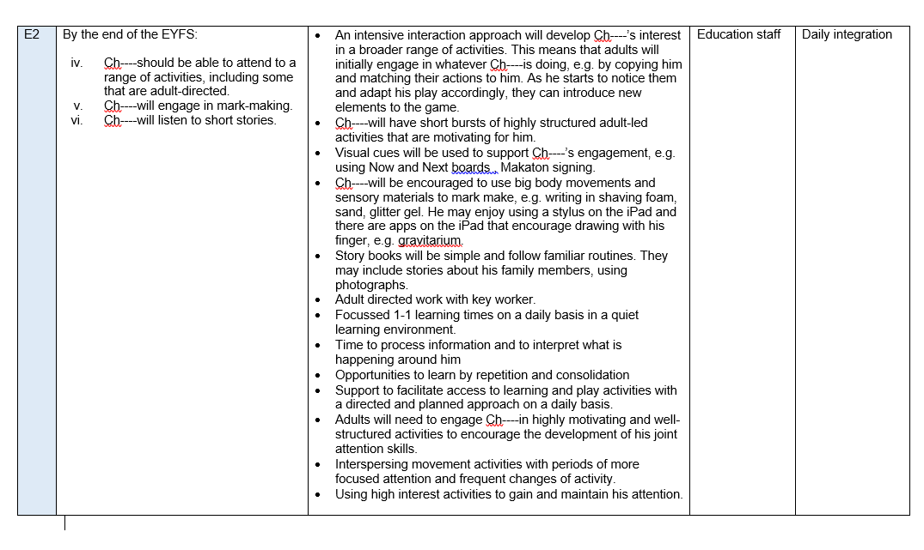
What the EHCP looks like:

Slide 7
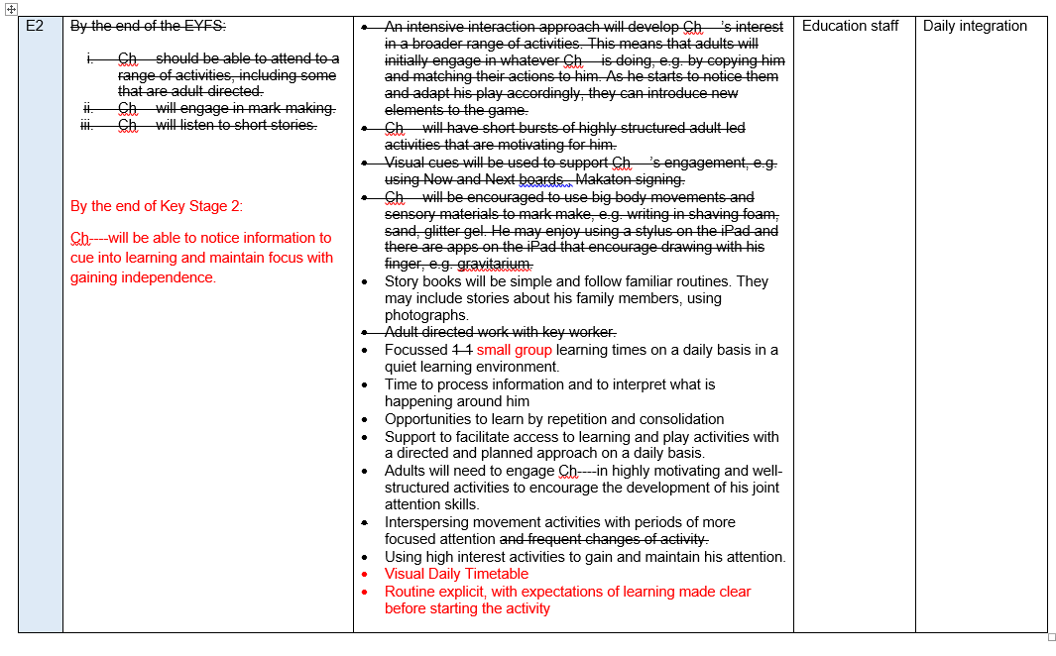
What the EHCP looks like when I send it to you and county:

Slide 8
APDRs Assess-Plan-Do-Review
APDRs are short termed targets set against EHCP outcomes
The targets are written by classroom staff, therapists, and senior leadership as applicable
We take the first half term after a child starts to write appropriate targets
We then write the provision for that target
When we send it to you, we will have a comment on the child’s progress

Slide 9
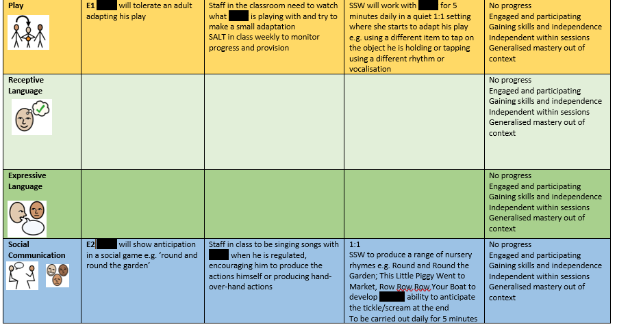
APDRs Assess-Plan-Do-Review
For example:
Outcome 2 from the EHCP:
By the end of KS1 Stage, Ch will be able to:
Understand a range of everyday instructions.
Express his wants and needs verbally and/or non-verbally with maximum level of support and begin to comment on the shared activity
Take part in some whole class activities with minimal adult support

Slide 10

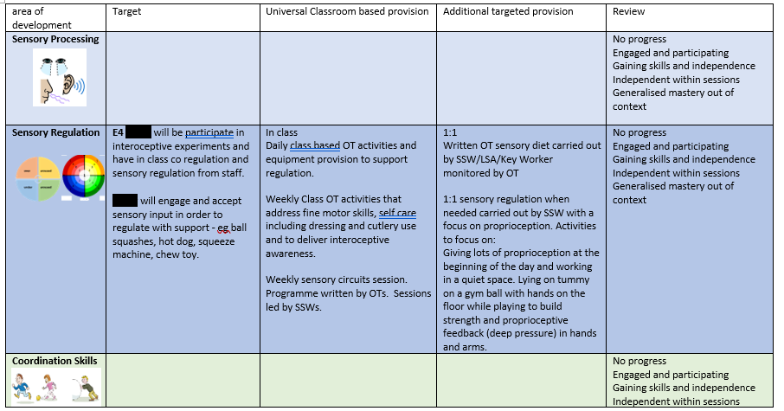
APDRs Assess-Plan-Do-Review
For example:
Outcome 4 from the EHCP:
Ch will be able to use taught strategies to co-regulate with adult support

Slide 11
Secondary Transfer
County has requested that Year 5 children have their annual review in the Summer term of Year 5
You will receive your paperwork as you have before, 2 weeks ahead of time for the meeting (see above)
You will need to come prepared to discuss your preference for Secondary Schools in that meeting, and tell me your decision
We then submit all the most up to date paperwork and documentation to the Local Authority ready for placement panel in the Autumn term when they are a Year 6.
Therefore, you need to have done your research and visited schools before Summer term of Year 5
Information about the schools available within Buckinghamshire is available here:
https://familyinfo.buckinghamshire.gov.uk/send/education-and-send/education-options-children-and-young-people-send/#special-schools
If you are from another local authority, please look at your Local Authority’s ‘local offer’ page.
The Local Authority have stated that they will have the EHCP from the Year 5 Annual Review/ Transfer review amended and finalised, with secondary school named, in the February of the child’s Year 6.

Slide 12
Year 5 transfer:
First
Year 4/beginning of Year 5: start your research!
Then
Year 5 Annual review: Summer term of Year 5.State your preference
Paperwork goes for consultation to Secondary Schools, Autumn of Year 6
You hear the results and receive a final EHCP, February of Year 6
Westfield begins transition plans with Secondary schools, new school to attend Annual Review in Summer of Year 6
County updates the EHCP
Next

