Slide 1

Welcome to Apple Tree Base
September 2023

Slide 2

Whole School
Apple Tree Base Pear Tree Base Cherry Tree Base
Blends learning through play/formal learning environment.
EYFS/CHERRY GARDEN
Moving towards a structured and timetabled classroom environment
Specialist Curriculum Inc Interventions
National Curriculum Apple Pear Cherry

Slide 3
Apple Base
The delivery of the curriculum is based around learning through play to engage children with active learning, exploration and becoming a critical thinker. Linked to intentions in the EHCP to ensure that learning is relevant and personalised.

Slide 4
Pear Base
Delivery of the National curriculum takes place through a structured and timetabled classroom environment, that blends learning through play and exploration with a transition towards a more formal learning environment.

Slide 5
Cherry Base
Delivery of the curriculum takes place through a structured and timetabled classroom environment
Targeted interventions related to each child’s academic needs

Slide 6
Staff
Mrs Holmes
Apple 1
Miss Doonan
Apple 2
Please see website for whole school staff list

Slide 7
A day in Apple Tree base:
9:00 | 9:10 | 9:15 | 10:05 | 10:15 | 10:30 | 10:45 | 11:00 | 11:50 | 12:00 | 12:30 | 1:00 | 1:10 | 3:15
Arrival/ Register | Wake and Shake | Communication Language & Literacy: Sensory Stories/ Phonics | Snack | Makaton Singing | Play Time | Bucket Time | Maths | Tidy up | Lunch | Play Time | Calm classroom | Foundation subjects APDRs, Interventions etc., carousel | Home Time
Additions throughout the week:
Sensory Circuits in the PE hall: Tuesday am
Forest School: Fridays
PE coach: Fridays
Food group: Tuesday am
Speech and Language therapist: Mondays
Occupational Therapist: Thursdays
PPA with Mr Ricketts
SSWs throughout the week

Slide 8
An example lesson in Apple Tree base:
Fine Motor skills:
Mark making (colouring attached to the story)
Play dough to strengthen hand muscles
Punch holes in a paper plate (cloud) and thread beads on to pipe cleaners (rain drops)
Whole class input:
Sensory story:
We gather around the table to interact with the objects related to the story (eg. vocab for sounds)
Speech and Language Vocabulary building:
Using Shape coding and Makaton, can you choose the right word for the musical instrument exploration?
Quiet/Loud, Fast/Slow
Sensory play:
Explore the story’s resources to make your own rain stick.

Slide 9
Communication:
By email or phone to office | Class staff via Tapestry App
From Parents Absences Medical updates Events at home which may affect the child’s day at school Change in drop off or collection arrangements Taxi issues Payments Uniform Queries about EHCp and provision Queries or concerns for attention of Assistant Heads From School Information and consent for trips and events Whole school newsletter and information Statutory reports for Annual Reviews of the EHCp and Annual Academic Reports Time allocations and invitations to meetings and workshops Electronic surveys and consultations Website Copies of newsletters, accounts of enrichment days and letters recently sent out Policies Term Dates and diary of events Uniform List | From Staff Progress and developmental steps reached during the week Updates on day’s or week’s events in class Reminders about upcoming events/trips Reporting incidents and accidents if you cannot be reached by phone In the event of remote learning, learning tasks and links. From Parents Lost/forgotten property Developmental “firsts” that happen at home
Tapestry: Have you all signed up? Can you all see it?
Teachers will be uploading a few times a week what we are working on and learning this week.
Teacher meetings: Meet the teacher 3 times a year. Teachers will also give you a phone call half-termly to catch up and fill you in on your child’s progress
EHCP annual reviews: See below

Slide 10
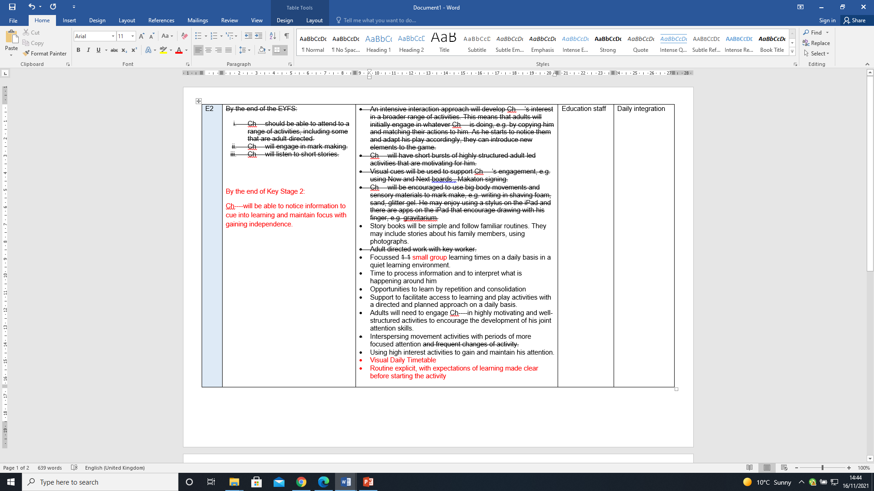
EHCP Annual Review
The meeting itself:
We will discuss your contribution
We will then review the reports
I will discuss the changes we would like to make for your approval
After the meeting, I will write up the changes and send them off to county and to you to review. Please check that you are happy with the changes

Slide 11
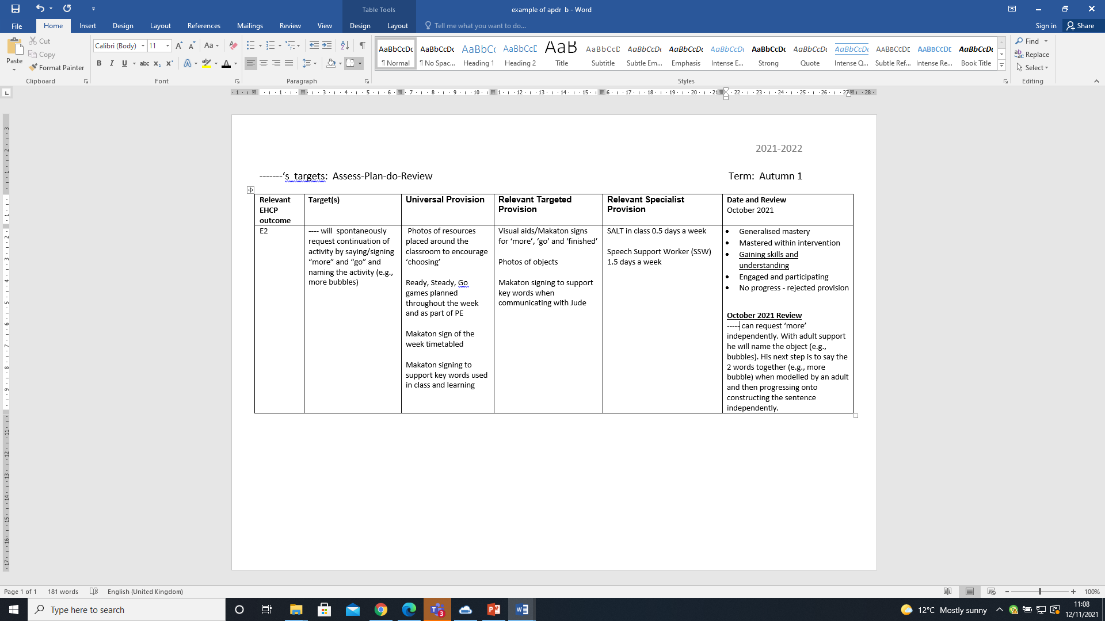
APDRs Assess-Plan-Do-Review
APDRs are short termed targets set against EHCP outcomes
The targets are written by classroom staff, therapists, and senior leadership as applicable
We take the first half term after a child starts to write appropriate targets. You will receive the targets before October half-term.
You will then receive progress comments in February and July
December 2021
Review
**Please note: We are changing the formatting of our APDRs this year. The document will look different, more details to follow.

Slide 12
Coming up
16th and 30th October 3.30pm-4.45pm Meet the Teacher sessions (TEAMS or Face to Face in school)
5th and 19th February 3.30pm-4.45pm Meet the Teacher sessions (TEAMS or Face to Face in school)
Parent Workshops (all face to face at school) 1.15pm-2.30pm
4th Oct The Westfield Curriculum (what do we teach, how and why?)
15th Nov Maths Mastery: What is it and how to support your child
6th Dec Communication, Language and Literacy Curriculum: What is it and how to support your child
24th Jan: Transition to Secondary school for parents of Year 5 pupils (What is the process, what is expected of parents)
6th March: The Emotion Wheel and Interoception (How to support children’s development of recognition of emotions and arousal levels)
24th April: Independence Curriculum (how we support children to develop independence in everyday life)
Parents into school sessions: Timings to be confirmed
Autumn Term
18th Dec: Apple Base Christmas Party
Spring Term
22nd March: Apple Base Forest School
Summer Term
1st July: Apple Base music and movement with Curly Cath

Slide 13
Extra information:
Please label everything that comes into school
Please send in a set of spare clothes
9:15 is the official start time for registration.
The numbers used for the classes are geographical, not based on ability or progress! Think of them as street addresses. There is no set rule how you move up through the bases. It depends on the intake of that year, and the provision your child needs.
If you are not able to access Tapestry, please inform us so that we can resolve the issue.
Questions/ answers from the session:
We are a school and unfortunately do not have the means to have daily communication with parents as you had at nursery. Please see slide above for communication you do receive. Please remember that if you contact a teacher during the day, they are in the middle of teaching. They will not be able to respond immediately. If your query is urgent, contact the office.
PE kits: Please send in a PE kit to school. We will return it to you at half-term. We sometimes end up using it as spare clothes, if needed.
All children work with all members of staff from their class for learning and play. They do have a named LSA from their classroom who monitors nappy changes/ toileting and has specific APDR targets to work on with the child. When we have set this up, we will let you know. But please keep in mind, this will change, and will change on the day with staffing levels. They do not have a “key worker” in the same way they had at nursery.
If you ever miss a newsletter, please see the website. They are under the “Parent and Guardian” area, you will find them under “Letters”
If we have a strategy that we have trialled at school that is proving successful, we will let you know so that you can use it at home, if you so wish.
We will have a Makaton sign of the week on Tapestry, if you wish to practice your Makaton at home. This will be up and running sometime this half-term.

