Slide 1


Welcome to Cherry Base
Emma Skeldon – Assistant Headteacher (Cherry Base)

Slide 2

Whole School
Westfield School is a Primary age special school which caters for children experiencing Communication and Interaction difficulties within a moderate learning difficulty / mild learning disability range.
The vast majority of our pupils have a diagnosis of ASD alongside other difficulties such as Global Developmental Delay, anxiety, sensory processing, ADHD and dyspraxia for example and / or a speech, language and communication difficulty

Slide 3

Whole School
Apple Tree Base Pear Tree Base Cherry Tree Base
Blends learning through play/formal learning environment.
EYFS/CHERRY GARDEN
Moving towards a structured and timetabled classroom environment
Specialist Curriculum Inc Interventions
National Curriculum Apple Pear Cherry

Slide 4
Apple Base
The delivery of the curriculum is based around learning through play to engage children with active learning, exploration and becoming a critical thinker. Linked to intentions in the EHCP to ensure that learning is relevant and personalised.

Slide 5
Pear Base
Delivery of the National curriculum takes place through a structured and timetabled classroom environment, that blends learning through play and exploration with a transition towards a more formal learning environment.

Slide 6
Cherry Base
Delivery of the curriculum takes place through a structured and timetabled classroom environment
Targeted interventions related to each child’s academic needs

Slide 7

Staff
Cherry 1
Miss Allen
Cherry 2
Mrs Williams
Cherry 3
Mrs Stephens
Cherry 4
Miss Collins
Mrs Bates
Mrs Stiranjan
Miss Moore
Miss Thomas
Mrs Proctor
Mrs Bashir
Miss Barszsz
Specialist Support Workers (SSW)
Cherry 1 and 4- Mrs Ritedyk
Cherry 2 and 3- Mrs Johnson

Slide 8
A day in Cherry Tree base:
am | MON | TUES | WED | THURS | FRI
9.00 – 9.15 | Table Activities | Table Activities | Table Activities | Table Activities | Table Activities
9.15 | OT Bilateral co-ordination | OT Bilateral co-ordination | OT Bilateral co-ordination | OT Bilateral co-ordination | OT Bilateral co-ordination
9.20– 10.25 | LITERACY | LITERACY | LITERACY | LITERACY | LITERACY A
10.30 | S | N | A | C | K
10.40 | B | R | E | A | K
10.50 – 10.55 | Number transition | Number transition | Number transition | Number transition | Number transition
10.55 – 12.00 | MATHS | MATHS | MATHS | MATHS | MATHS
Additions throughout the week:
Sensory Circuits in the PE hall: Curly Kath – Spring term
PE Food group/dressing group
Swimming
SaLT/OT Specialist/targeted 1:1/ 2:1 interventions
12.00 – 12.30 | L | U | N | C | H
12.30 – 1.00 | PLAY | FOREST SCHOOL | PLAY | PLAY | PLAY
1.00 – 1.10 | OT Fine Motor | FOREST SCHOOL | SPECIALIST GROSS MOTOR INTERVENTION (PPA) | OT Fine Motor | OT Fine Motor
1.10 – 1.25 | Assembly-social thinking | FOREST SCHOOL | SPECIALIST GROSS MOTOR SKILLS INTERVENTION (PPA) | Assembly-social thinking | Assembly-social thinking
1.25- 1.40 | READING | FOREST SCHOOL | SPECIALIST GROSS MOTOR SKILLS INTERVENTION (PPA) | READING | READING
1.40 – 1.45 | FITNESS | FOREST SCHOOL | SPECIALIST GROSS MOTOR SKILLS INTERVENTION (PPA) | FITNESS | FITNESS
1.45 – 2.45 | FOUNDATION | FOREST SCHOOL | INTEROCEPTION, SOCIAL SKILLS COMMUNICATION INTERVENTION (PPA) | FOUNDATION | RHE
2.45 – 2.50 | TIDYING | FOREST SCHOOL | TIDYING | TIDYING | TIDYING
2.50 | SOCIAL INTERACTION TIME | FOREST SCHOOL | SOCIAL INTERACTION TIME | SOCIAL INTERACTION TIME | SOCIAL INTERACTION TIME
3.15 | TAXIS | TAXIS | TAXIS | TAXIS | TAXIS

Slide 9
3 Part Lesson Plan:
Y2 S2: Relate grouping problems where the number of groups is unknown to multiplication equations with a missing factor, and to division equations (quotitive division). LO: I can find the missing factor in a grouping problem.
Do now: Vocab input | Key vocab : factor, equal group skip step counting 2s, 5s, 10s
New Learning: | Lesson 1: PP slide 1 and 2 | Lesson 2: Slide 6 | Lesson 3: Slide 7 | Lesson 4: Slide 8,9,10
Talk Task | PP Slide 3 and 4 |  |  | Slide 11 with coins Concrete : show with coins Concrete to Pictorial: Draw answers and write division sentences Pictorial: Solve division through drawing solution and writing division stories.
Develop Learning (TD) | Pictorial : 1m long string How many 10cm pieces do you think I can cut from the ribbon? What do the 10 and the 60 represent in the missing number calculation? What does the missing factor represent? What multiples do you think we should skip count in, or which times table fact should we use, to find the answer? So, if I have 60cm of ribbon, I can cut _____ pieces which are each 10cm long from it. Show pictorially and write corresponding division sentence. | Concrete : 1m long string How many 10cm pieces do you think I can cut from the ribbon? What do the 10 and the 60 represent in the missing number calculation? What does the missing factor represent? So, if I have 60cm of ribbon, I can cut _____ pieces which are each 10cm long from it. Repeat with Denes | Concrete to pictorial : 1m long string How many 10cm pieces do you think I can cut from the ribbon? What do the 10 and the 60 represent in the missing number calculation? What does the missing factor represent? What multiples do you think we should skip count in, or which times table fact should we use, to find the answer? So, if I have 60cm of ribbon, I can cut _____ pieces which are each 10cm long from it. Repeat with Denes and record pictorially.
Develop Learning (NJ) | Concrete Slide 5 (pots) counters shared into pots 6 seeds, how many pots do I need for 2 seeds in each pot? Can you divide 6 cubes into groups of 2? How many pots will you need? If you use skip counting, what multiples will you need to count in? Repeat using 10 seeds, 14 seeds etc | Concrete to pictorial Slide 5 (pots) counters shared into pots 6 seeds, how many pots do I need for 2 seeds in each pot? Can you divide 6 cubes into groups of 2? How many pots will you need? How can you show me your thinking on paper? If you use skip counting, what multiples will you need to count in? Choose relevant denes blocks to use. Repeat using 10 seeds, 14 seeds etc | Pictorial Slide 5 (pots) counters shared into pots 6 seeds, how many pots do I need for 2 seeds in each pot? Can you divide 6 cubes into groups of 2? How many pots will you need? How can you show me your thinking on paper? If you use skip counting, what multiples will you need to count in? Repeat just using pictorial recording with “Can you write the division calculation to represent 6 divided by 2?” under each diagram
Independent Task | Maths seeds relevant section + Matching division cards with cubes

Slide 10


Carousel system and embedded provision
Miss Barszcz
Apostrophe for possession / English Type
Whole class input
Mrs Williams
The Disgusting Sandwich
Sentence writing
Mrs Johnson
Vocabulary

Slide 11






Carousel - Science

Slide 12
Communication, Language and Literacy Carousel 15.9.23
Group 1
Miss Shree
Apostrophe for possession / English Type
Mrs Johnson
Vocabulary
Mrs Williams
The Disgusting Sandwich Sentence writing
Group 2
Miss Shree
‘ea’ grapheme / English Type
Mrs Williams
The Disgusting Sandwich
Sentence writing
Mrs Johnson
Vocabulary
Group 3
Mrs Williams
The Disgusting Sandwich Sentence writing
Miss Shree
‘qu’ grapheme / English Type
Mrs Johnson
Vocabulary

Slide 13
Handwriting 15.9.23
Mrs Collins
FOCUS
Writing on the line
Group 1
Mrs WIlliams
FOCUS
g, y, j
on and below the line
Group 2
Miss Shree
FOCUS
Ladder letters
Group 3

Slide 14
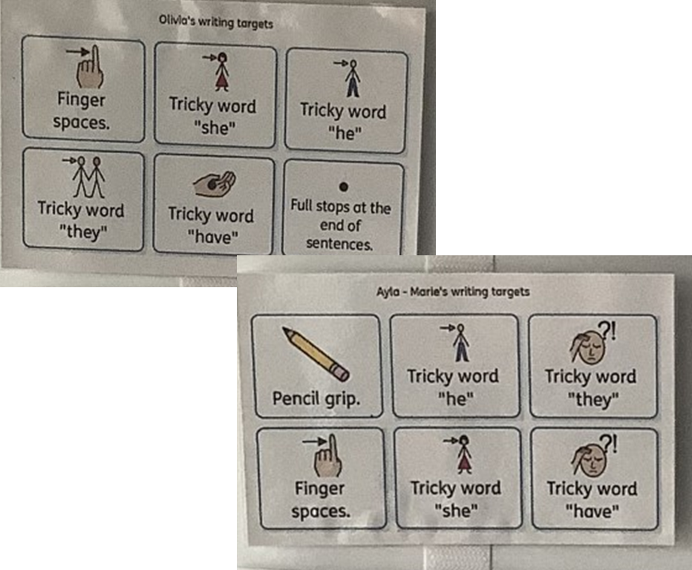
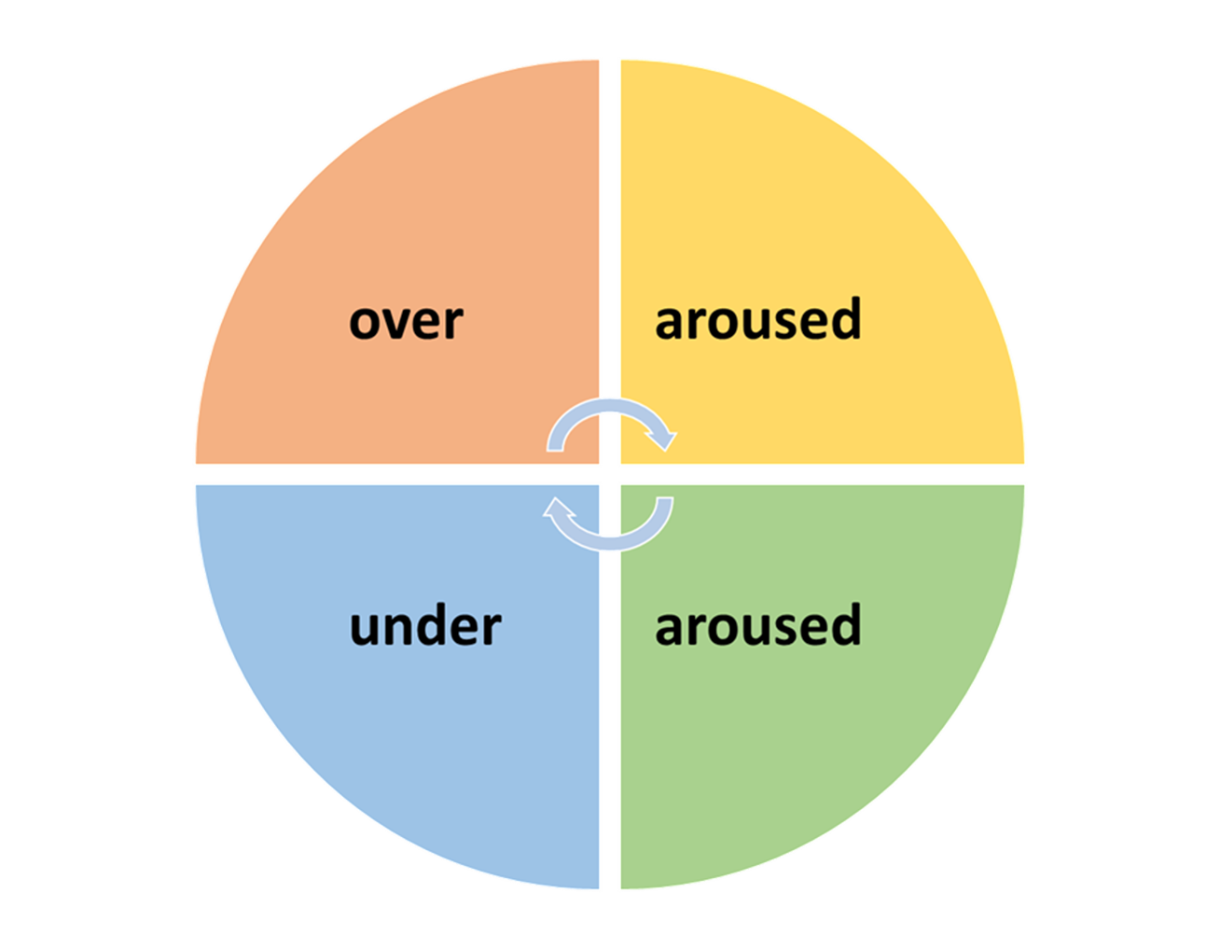
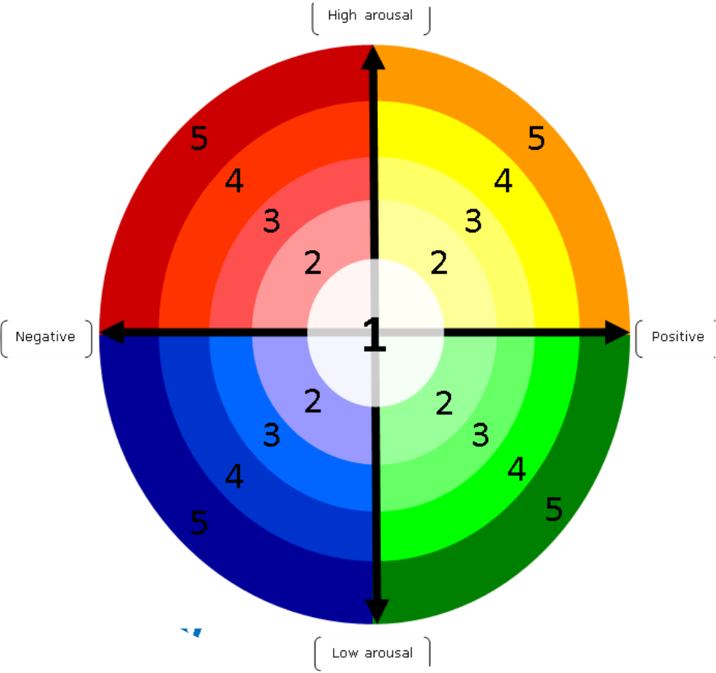
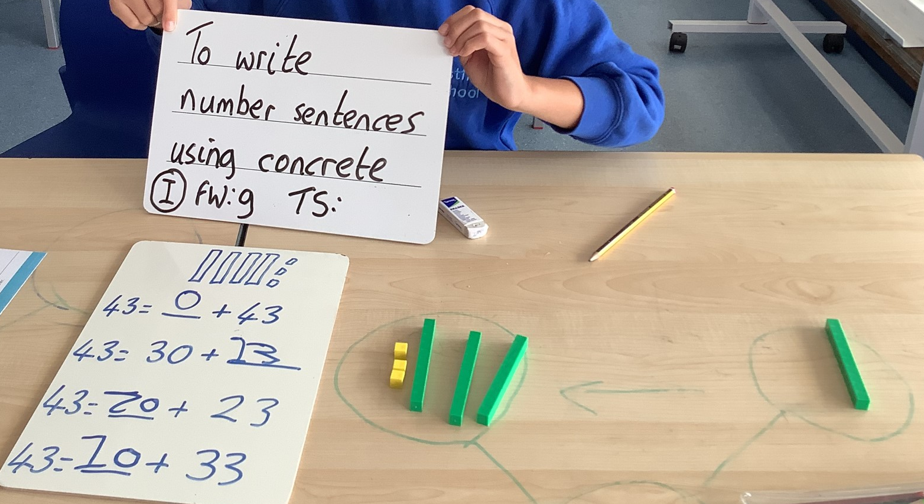
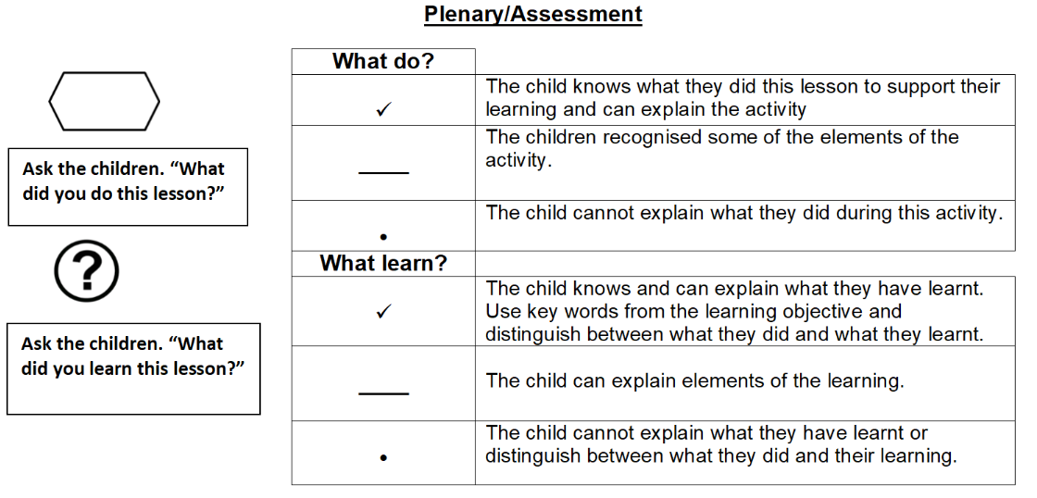
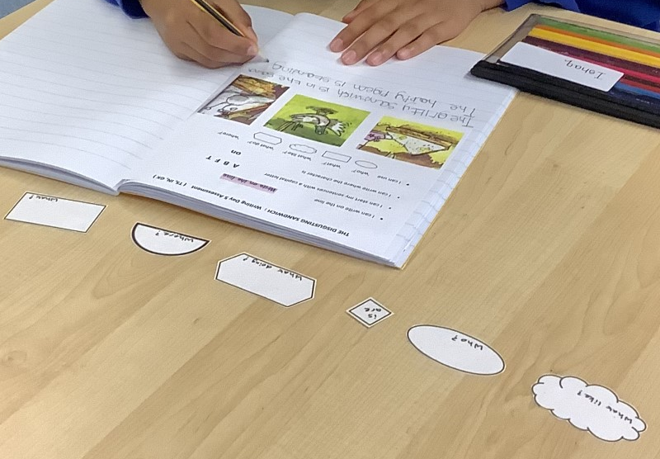
Visuals
Visuals to support Learning
Visuals to support regulation
Visuals to support self assessment

Slide 15
Communication:
By email or phone to office | Class staff via SeeSaw App
From Parents Absences Medical updates Events at home which may affect the child’s day at school Change in drop off or collection arrangements Taxi issues Payments Uniform Queries about EHCp and provision Queries or concerns for attention of Assistant Heads From School Information and consent for trips and events Whole school newsletter and information Statutory reports for Annual Reviews of the EHCp and Annual Academic Reports Time allocations and invitations to meetings and workshops Electronic surveys and consultations Website Copies of newsletters, accounts of enrichment days and letters recently sent out Policies Term Dates and diary of events Uniform List | From Staff Progress and developmental steps reached during the week Updates on day’s or week’s events in class Reminders about upcoming events/trips Reporting incidents and accidents if you cannot be reached by phone In the event of remote learning, learning tasks and links. From Parents Lost/forgotten property Developmental “firsts” that happen at home

Slide 16
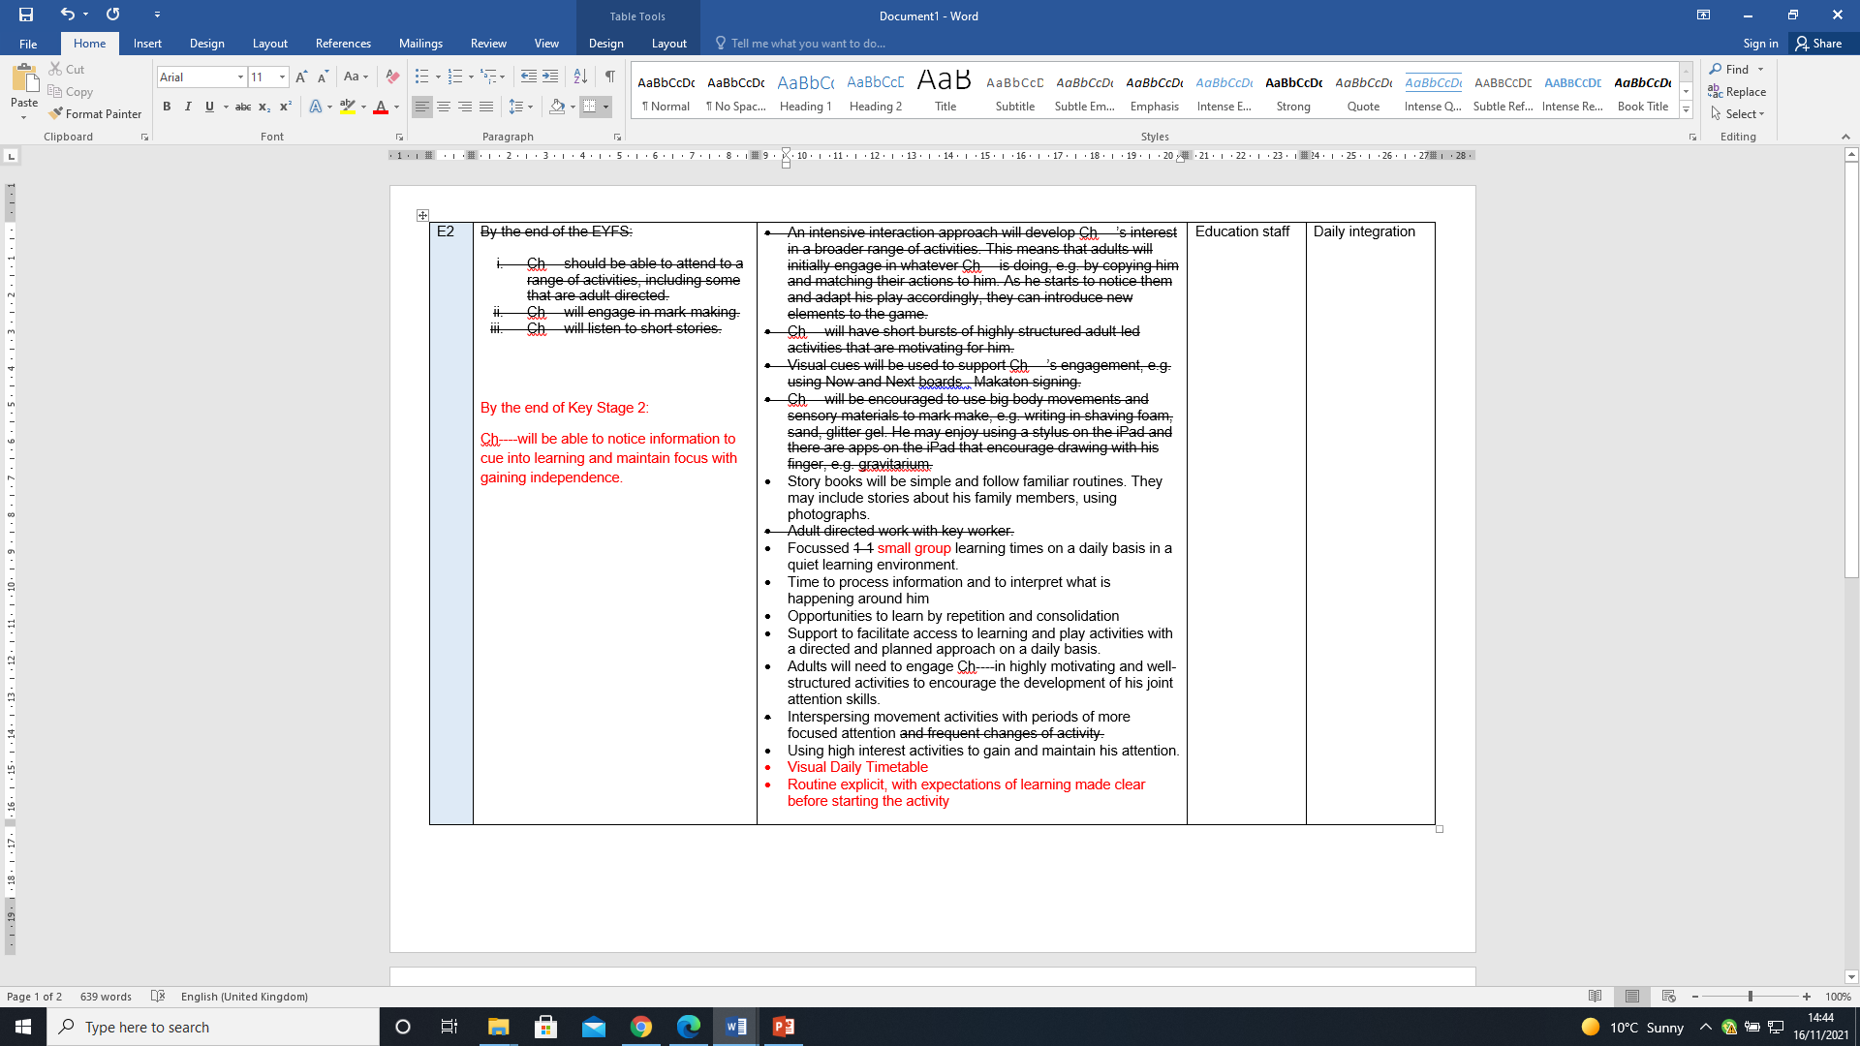
EHCP Annual Review
The meeting itself:
We will review the child’s contribution (teachers and parents can contribute if needed)
We will discuss your contribution
We will then review the reports
I will discuss the changes we would like to make for your approval
After the meeting, I will write up the changes and send them off to county and to you to review. Please check that you are happy with the changes

Slide 17
Year 5 transfer review:
Year 4/beginning of Year 5: start your research!
Year 5 Annual review: Summer term of Year 5.State your preference
Paperwork goes for consultation to Secondary Schools, Autumn of Year 6
You hear the results and receive a final EHCP, February of Year 6
Westfield begins transition plans with Secondary schools, new school to attend Annual Review in Summer of Year 6
County updates the EHCP
Information about the schools available within Buckinghamshire is available here:
https://familyinfo.buckinghamshire.gov.uk/send/education-and-send/education-options-children-and-young-people-send/#special-schools
If you are from another local authority, please look at your Local Authority’s ‘local offer’ page.

Slide 18
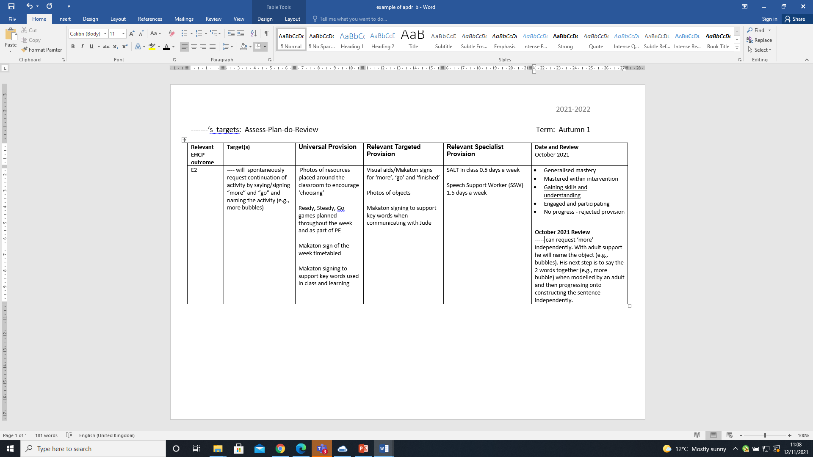
APDRs Assess-Plan-Do-Review
APDRs are short termed targets set against EHCP outcomes
The targets are written by classroom staff, therapists, and senior leadership as applicable
We take the first half term after a child starts to write appropriate targets. You will receive the targets before October half-term.
You will then receive progress comments in February and July
December 2021
Review

Slide 19
Coming up
Meet the Teacher sessions (TEAMS or Face to Face in school)
16th and 30th October 3.30pm-4.45pm
5th and 19th February 3.30pm-4.45pm
Parent Workshops (all face to face at school) 1.15pm-2.30pm
4th Oct The Westfield Curriculum (what do we teach, how and why?)
15th Nov Maths Mastery: What is it and how to support your child
6th Dec Communication, Language and Literacy Curriculum: What is it and how to support your child
24th Jan : Transition to Secondary school for parents of Year 5 pupils (What is the process, what is expected of parents)
6th March : The Emotion Wheel and Interoception (How to support children’s development of recognition of emotions and arousal levels)
24th April : Independence Curriculum (how we support children to develop independence in every day life)
Parents into school sessions: Timings to be confirmed
Autumn Term
12th Dec : Cherry Base Christmas Celebration
Spring Term
26th March : Cherry Base Easter hunt and tea party
Summer Term
Week beginning 8th July : Pear and Cherry base Forest School sessions

Slide 20
Questions

