Slide 1

Welcome to Apple Tree Base
September 2024

Slide 2

Whole School
Apple Tree Base Pear Tree Base Cherry Tree Base
Blends learning through play/formal learning environment.
EYFS/CHERRY GARDEN
Moving towards a structured and timetabled classroom environment
Specialist Curriculum Inc Interventions
National Curriculum Apple Pear Cherry

Slide 3

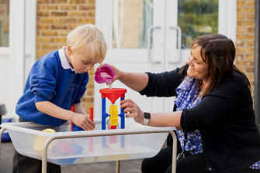
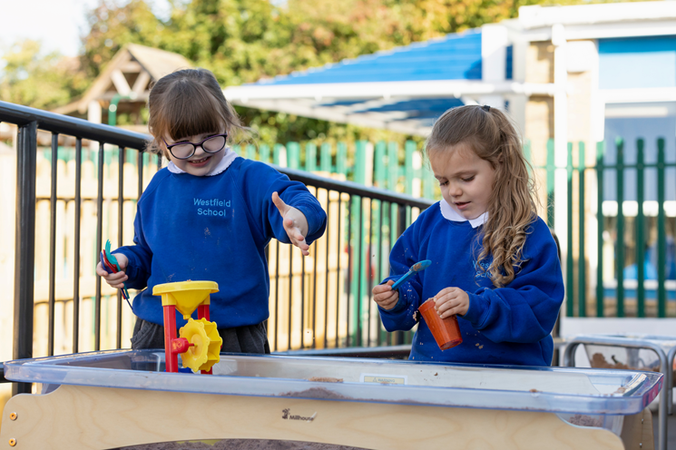
Apple Base
The delivery of the curriculum is based around learning through play to engage children with active learning, exploration and becoming a critical thinker. Linked to intentions in the EHCP to ensure that learning is relevant and personalised.

Slide 4

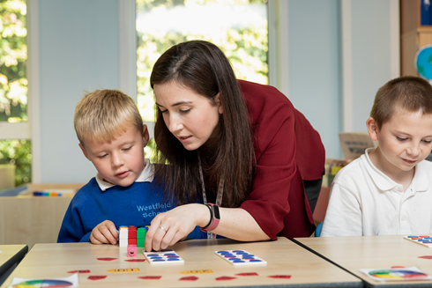
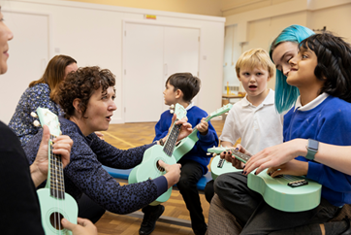
Pear Base
Delivery of the National curriculum takes place through a structured and timetabled classroom environment, that blends learning through play and exploration with a transition towards a more formal learning environment.

Slide 5



Cherry Base
Delivery of the curriculum takes place through a structured and timetabled classroom environment
Targeted interventions related to each child’s academic needs

Slide 6
A day in Apple Tree base:
9:00 | 9:20 | 9:30 | 10:00 | 10:20 | 10:40 | 10:55 | 11:00 | 11:40 | 12:00 | 12:30 | 1:00 | 1:15 | 1:25 | 2:20 | 2:45 | 3:15
Arrival/ Register/ Choosing activity | Wake and Shake | Maths | Tidy up/ Snack | Outside play | Bucket time | Sensory story/ Phonics | Communication, Language & Literacy: Phonics | Tidy up/ Nappy time/Toilet | Lunch | play time | Calm class room | Makaton singing | Living in the world | OT Gross motor – cherry playground | Nappy/Toilet Get ready for home | Taxi Time
Additions throughout the week:
Sensory Circuits in the PE hall: Wednesday am
Food group: Wednesday pm
Forest School: alternate Fridays
PE coach: Thursday
Speech and Language therapists: Monday, Wednesday or Thursday
Occupational Therapists: Wednesdays and Thursdays
PPA with Mr Fry (Apple 2 only) alternate Fridays
SSWs throughout the week

Slide 7
An example lesson in Apple Tree base:
Fine Motor skills:
Mark making (colouring attached to the story)
Play dough to strengthen hand muscles
Punch holes in a paper plate (cloud) and thread beads on to pipe cleaners (rain drops)
Whole class input:
Sensory story:
We gather around the table to interact with the objects related to the story (eg. vocab for sounds)
Speech and Language Vocabulary building:
Using Shape coding and Makaton, can you choose the right word for the musical instrument exploration?
Quiet/Loud, Fast/Slow
Sensory play:
Explore the story’s resources to make your own rain stick.

Slide 8
Communication:
By email or phone to office office@westfield.bucks.sch.uk 01628533125 | Class staff via Tapestry App
From Parents Absences Medical updates Events at home which may affect the child’s day at school Change in drop off or collection arrangements Taxi issues that have been raised with transport Payments Uniform Queries about EHCp and provision Queries or concerns for attention of Assistant Heads From School Information and consent for trips and events Whole school newsletter and information Statutory reports for Annual Reviews of the EHCp and Annual Academic Reports Time allocations and invitations to meetings and workshops Electronic surveys and consultations Website Copies of newsletters, accounts of enrichment days and letters recently sent out Policies Term Dates and diary of events Uniform List | From Staff Progress and developmental steps reached during the week Updates on day’s or week’s events in class Reminders about upcoming events/trips Reporting incidents and accidents if you cannot be reached by phone In the event of remote learning, learning tasks and links. From Parents Lost/forgotten property Developmental “firsts” that happen at home
Tapestry: Have you all signed up? Can you all see it?
Teachers will be uploading a few times a week what we are working on and learning this week.
Teacher meetings: Meet the teacher 2 times a year. Teachers will also give you a phone call half-termly to catch up and fill you in on your child’s progress
EHCP annual reviews: See below

Slide 9
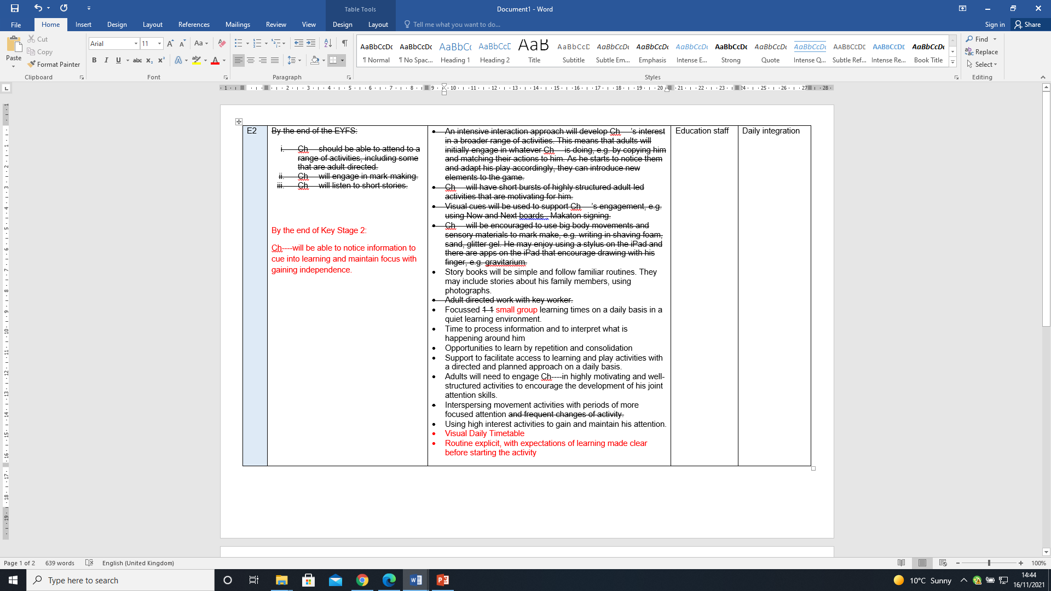
EHCP Annual Review
The meeting itself:
We will discuss your contribution
We will then review the reports
I will discuss the changes we would like to make for your approval
After the meeting, I will write up the changes and send them off to county and to you to review. Please check that you are happy with the changes

Slide 10
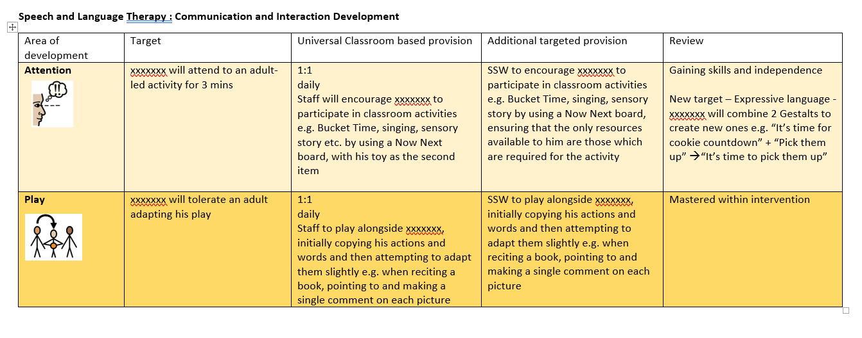
APDRs Assess-Plan-Do-Review
APDRs are short termed targets connected to EHCP outcomes
The targets are written by classroom staff, therapists, and senior leadership as applicable
We take the first half term after a child starts to write appropriate targets. You will receive the targets before October half-term.
You will then receive progress information in February and July
December 2021
Review

Slide 11
Coming up
21st and 23rd October 3.30pm-4.45pm Meet the Teacher sessions (TEAMS or Face to Face in school)
24th and 26th February 3.30pm-4.45pm Meet the Teacher sessions (TEAMS or Face to Face in school)
Parent Workshops 1.15pm-2.30pm
21st Oct Forest School at Westfield
18th Nov Living in the World Curriculum: What is it and how to support your child
11th Dec New assessment platform
Parents into school sessions: Timings to be confirmed
Autumn Term
20th Dec: Apple Base Christmas Party
Spring Term
28th March: Apple Base Forest School
Summer Term
14th July : Apple Base music and movement with Curly Kath

